Slide 1
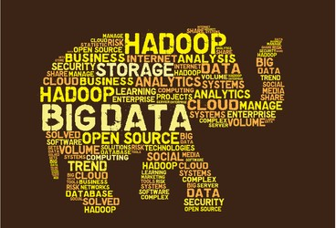
UNIT-1
Big Data Fundamentals
2

Slide 2
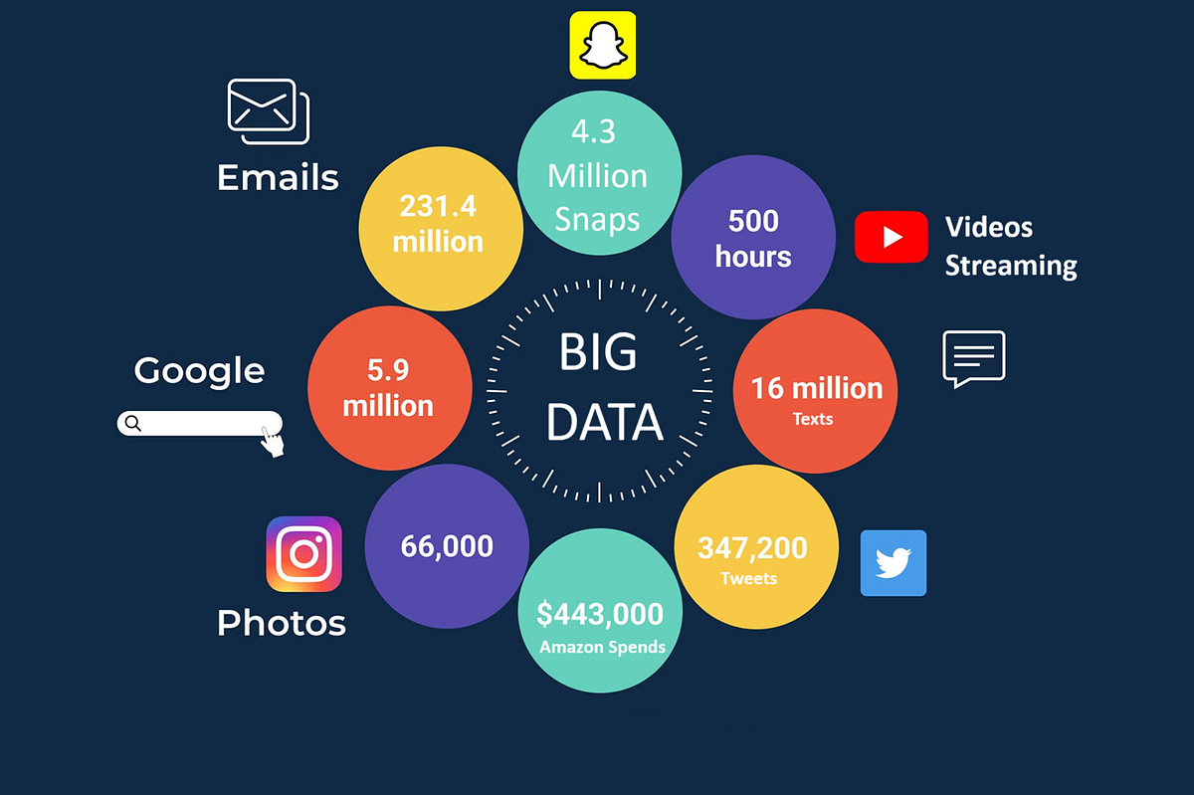
1. Characteristics & Challenges of Big Data
The 5 V's, Data Quality, Implementation Challenges
2. Data Life Cycle in Large-Scale Systems
Generation, Ingestion, Storage, Processing, Analysis, Visualization, Archival
Contents
3. Distributed Computing Models
Shared-Nothing, BSP, Stream Processing, Graph Processing, MapReduce
TABLE OF CONTENTS
4. Big Data Architecture
Layered, Stream, Lambda, Kappa, Data Lake
5. Performance Metrics
Latency, Throughput, Scalability, Resource Utilization
6. CAP Theorem & Cost Trade-offs
Consistency, Availability, Partition Tolerance, Storage vs Computation
7. Responsible AI & Data Governance
Governance Principles, Responsible AI, Big Data Pipeline Ethics
2

Slide 3
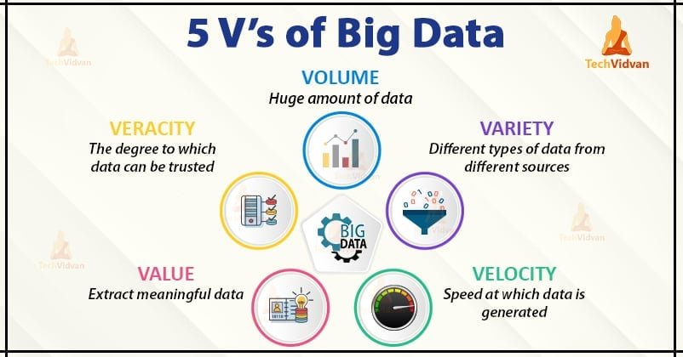
1. The 5 V's of Big Data
01 Big Data Basics
02 Data Life Cycle
Volume
Variety
Velocity
Veracity
Value
Enormous size of data
NYSE: 1TB/day
Facebook: 500+ TB/day
Jet engine: 10+ TB/30min
Different data types
Structured: SQL tables
Unstructured: images, videos
Semi-structured: XML, JSON
Speed of data creation
Real-time streaming
Application logs
Social media, sensors
Data reliability & quality
Filtering & cleaning
Quality assurance
Trustworthiness
Actionable insights
Not just storage
Process & analyze
Business value
03 Computing
Models
04 Architecture
Big Data is a collection of data that is huge in volume, growing exponentially with time. It is data with such large size and complexity that traditional data management tools cannot store or process it efficiently.
05 Performance
06 CAP &
Trade-offs
07 Responsible AI

Slide 4
5
1. Six Key Data Quality Characteristics
Characteristic | Description
Accuracy | Data should be sufficiently accurate for the intended use and captured only once at the point of activity.
Validity | Data should be recorded and used in compliance with relevant rules or definitions to ensure consistency.
Reliability | Data should reflect stable and consistent collection processes across collection points and over time.
Timeliness | Data should be captured as quickly as possible after the event and be available within a reasonable time.
Relevance | Data captured should be relevant to the purposes for which it is to be used; periodic review required.
Completeness | Data requirements should be clearly specified based on organizational information needs.

Slide 5
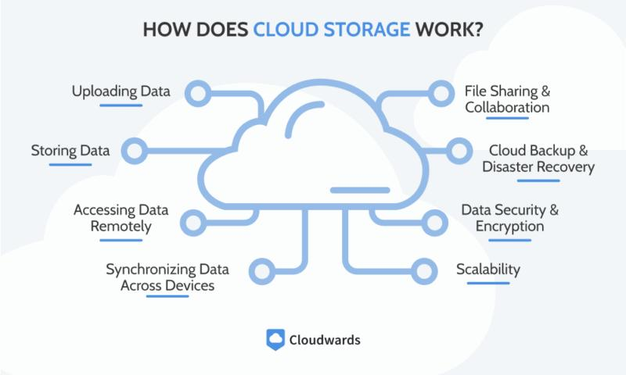
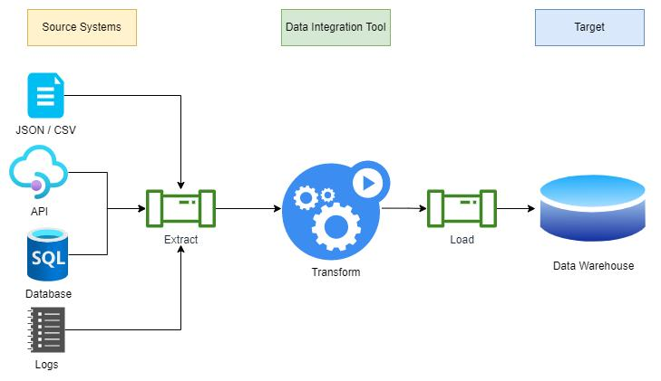
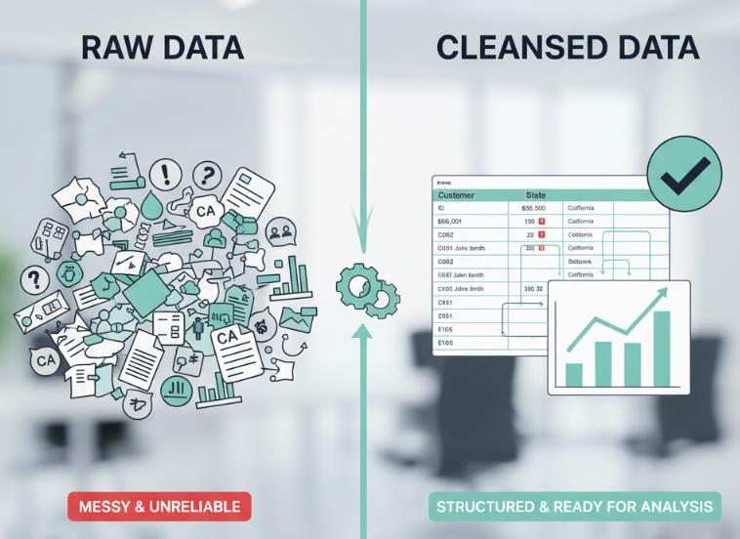
6
Challenges of Big Data (Part 1)
1. Managing Massive Amounts of Data
Storage capacity of traditional data centers becomes inadequate.
Solution: Migrate IT infrastructure to the cloud for dynamic scaling.
2. Integrating Data from Multiple Sources
Data from analytics, social media, CRM, emails with different structures.
Solution: Use ETL tools and BI software for unified structure.
3. Ensuring Data Quality
Analytics and ML depend on clean, accurate data. Quality assurance becomes harder as
sources increase. Solution: Data governance applications.
4. Keeping Data Secure
Companies handle sensitive financial data, personal info, and proprietary data.
Solution: Encryption, access controls, endpoint protection, monitoring.
5. Selecting the Right Big Data Tools
The wealth of available tools is itself a challenge.
Solution: Hire specialists to determine which tools fit needs and configure ETL solutions.
6. Scaling Systems and Costs Efficiently
Without planning, projects can waste money storing useless data.
Solution: Start with clear goals, define schemas, create purging policies.

Slide 6
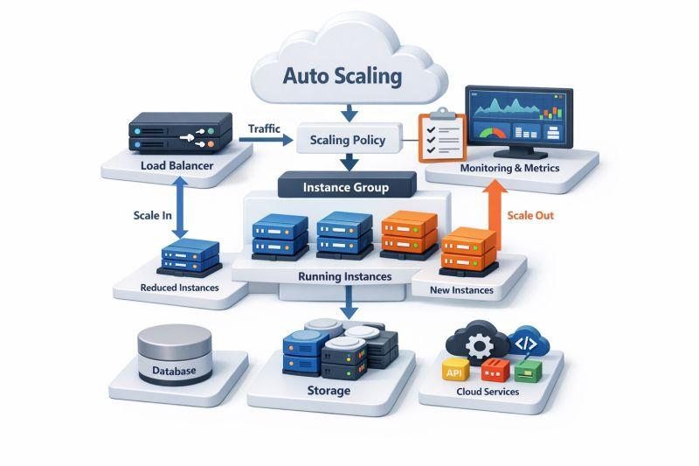
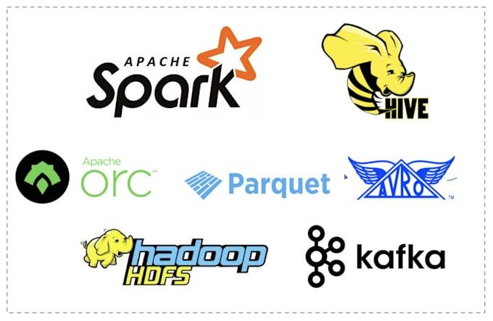
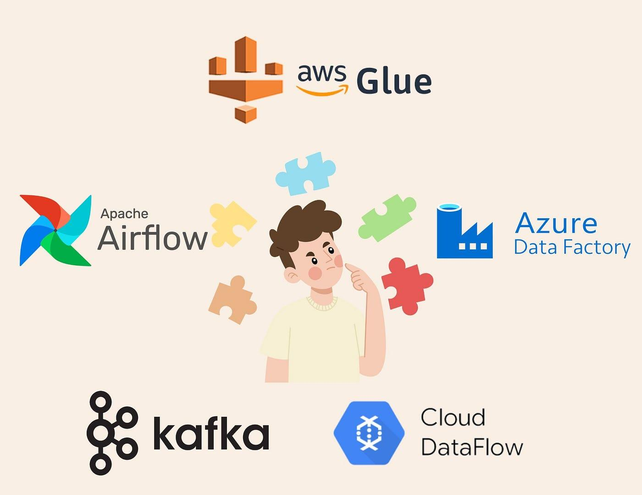
7
Challenges of Big Data (Part 2)
7. Lack of Skilled Data Professionals
Working with big data requires specialized skills.
Solution: Hire specialists, provide training, or choose self-service analytics.
8. Organizational Resistance
Large organizations resist change. Leaders may not see value in big data.
Solution: Start small, let results prove value, place experts in leadership.

Slide 7
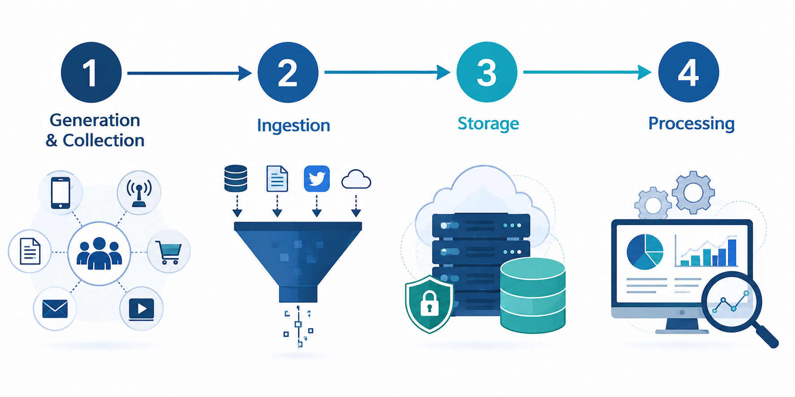
9
2. Data Life Cycle: Generation to Processing
1
2
3
4
Generation
& Collection
Ingestion
Storage
Processing

Slide 8
9
Data Life Cycle: Generation to Processing
1. Data Generation / Collection
2. Data Ingestion
Data generated from sensors, web logs, social media, transactional systems, and IoT devices. Collection mechanisms include batch ingestion, real-time streaming (Apache Kafka, Flume), and direct database imports (Sqoop).
Raw data is brought into the storage layer. Apache Sqoop for structured data import/export from SQL to HDFS. Apache Flume for ingesting unstructured and streaming data. Involves format conversion and deduplication.
3. Data Storage
4. Data Processing
Distributed storage using HDFS (Hadoop Distributed File System). Data stored in 128 MB blocks across multiple DataNodes with replication for fault tolerance. NoSQL databases (MongoDB, Cassandra, HBase) also used.
Batch Processing: MapReduce framework processes large datasets in parallel across a cluster. Stream Processing: Real-time processing using Apache Spark Streaming for continuously arriving data.

Slide 9
9
Data Life Cycle: Generation to Processing
5
Data Analysis & Analytics
Processed data is analyzed using Apache Hive (SQL-like queries), Apache Pig (data flow scripting), Apache Spark (in-memory analytics), and machine learning libraries. BI tools create reports, dashboards, and visualizations for decision-makers.
6
Data Visualization & Reporting
Results are presented through dashboards, charts, maps, and graphs. BI tools like Tableau, Power BI, and custom dashboards make data actionable. Visualization transforms raw analytics into insights that drive business decisions.
7
Data Archival / Deletion
Data no longer actively needed is archived to lower-cost storage tiers or deleted per governance policies. Data lifecycle management defines purging schedules to control costs and ensure compliance with retention regulations.

Slide 10
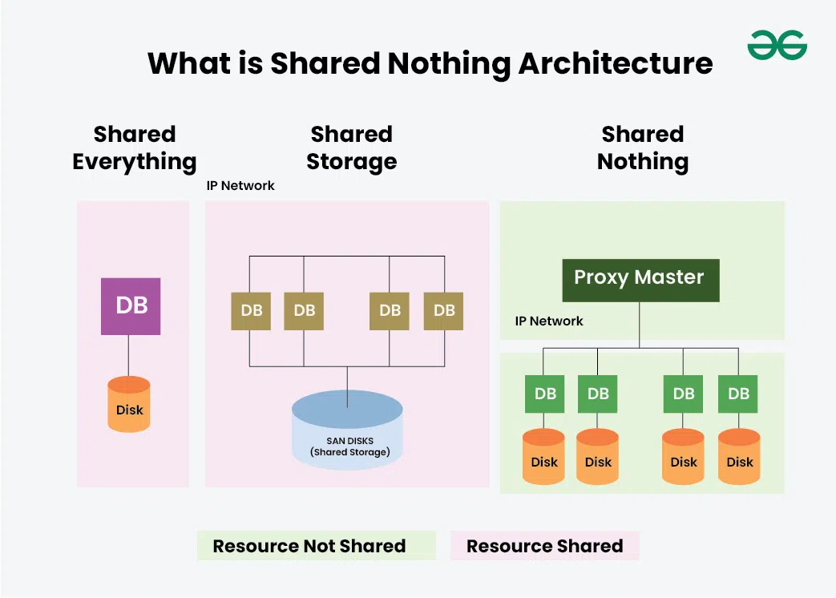
9
Shared-Nothing Architecture & BSP
Shared-Nothing Architecture
Bulk Synchronous Parallel (BSP)
Shared-Nothing Architecture
Each node in the cluster has its own dedicated CPU, memory, and disk storage. Nodes do not share memory or storage.
Key Characteristics:
• Less coordination overhead
• Higher distribution capability
• Highly scalable — linear capacity increase
Used by:
• NoSQL: Cassandra, MongoDB
• Hadoop HDFS
Contrast with:
• Shared Memory (Oracle 11g)
• Shared Disk (Oracle RAC)

Slide 11
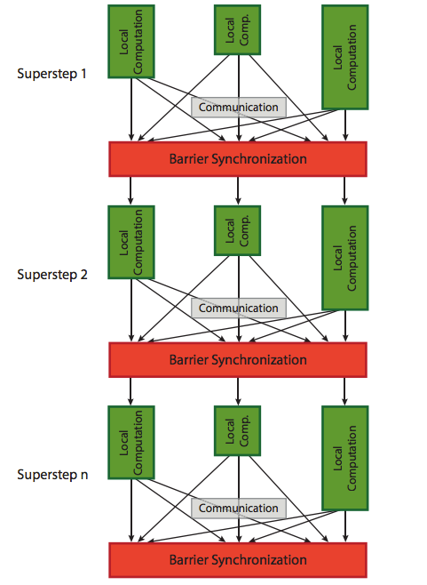
9
Shared-Nothing Architecture & BSP
Bulk Synchronous Parallel (BSP)
Computation proceeds in a series of supersteps. In each superstep:
1. Local computation on each processor
2. Global communication between processors
3. Barrier synchronization ensures all finish
Advantages:
• Predictable and easy to reason about
• Supports complex iterative algorithms
Used in:
• Google's Pregel (graph processing)
• Apache Giraph

Slide 12
9
Today’s Fact
Explosive Indian Data Center Infrastructure: India's data center market is experiencing historic growth driven by AI and enterprise demands. ST GDC India, a Tata-backed data center giant, is targeting a multi-billion dollar IPO to scale infrastructure. Meanwhile, companies are rapidly expanding facilities in alternative zones like GIFT City to meet local storage requirements and edge computing needs. [1, 2]
GenAI Data Engineering: Enterprises are increasingly turning to generative AI models to manage, clean, and extract value from massive, unstructured datasets rather than doing it manually. Tools like MotherDuck are using Python-based agentic tools to let users build and deploy data pipelines in minutes. [1, 2, 3]

Slide 13
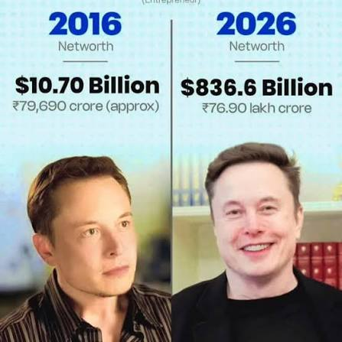
9
Today’s Fact
The global market for big data analytics in defense has reached an estimated $11.07 billion.
1 Billion = 10,000 Lakhs
https://natlawreview.com/press-releases/global-big-data-analytics-defense-aerospace-market-outlook-2026-growth

Slide 14
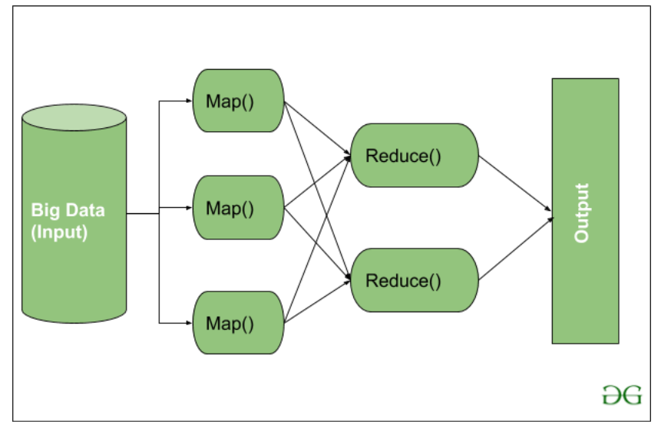
9
3. Stream Processing, Graph Processing & MapReduce
Stream Processing
Graph Processing
MapReduce
Handles data in real-time as it arrives.
Examples:
• Kafka Streams, Flink, Spark Streaming
Processes event-by-event or in micro-batches for low-latency responses.
Models data as nodes (vertices) and relationships (edges).
Used by: • Neo4J, Giraph, GraphX
Suited for social networks, recommendations, logistics.
Two-phase framework for distributed processing:
Map: Splits data, produces key-value pairs Reduce: Aggregates intermediate results
Languages: Java, Python, Ruby, C++
Model Comparison
Stream: Low latency, real-time decisions
Graph: Relationship-focused analytics
MapReduce: Batch, high throughput
Modern systems often combine these models — e.g., Spark supports batch, streaming, SQL, and graph processing in a unified framework.

Slide 15
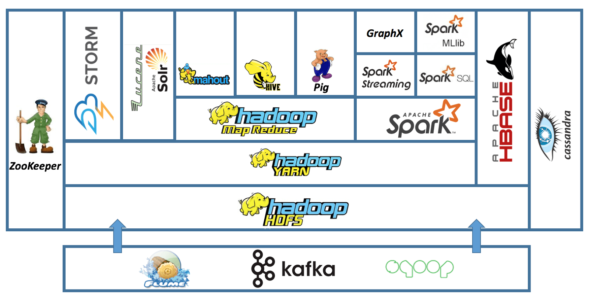
9

Slide 16
9
Hadoop Ecosystem comprises several components that work together for efficient big data storage and processing:
  HDFS (Hadoop Distributed File System): Stores large datasets across distributed nodes.
  YARN (Yet Another Resource Negotiator): Manages cluster resources and job scheduling.
  MapReduce: A programming model for batch data processing.
  Spark: Provides fast, in-memory data processing.
  Hive & Pig: High-level tools for querying and analyzing large datasets.
  HBase: A NoSQL database for real-time read/write access.
  Mahout & Spark MLlib: Libraries for scalable machine learning.
  Solr & Lucene: Tools for full-text search and indexing.
  Zookeeper: Manages coordination and configuration across the cluster.
  Oozie: A workflow scheduler for managing Hadoop jobs.

Slide 17
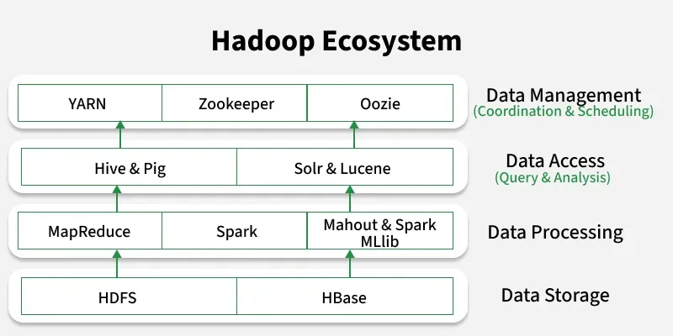
9
Layered & Stream Processing Architectures
Classic Layered Hadoop Architecture
Ecosystem Tools: Hive (SQL) | Pig (Data Flow) | HBase | Sqoop | Flume | Oozie
Processing Layer: MapReduce | Spark (Data Processing)
Resource Management: YARN (CPU & Memory)
Storage Layer: HDFS (Distributed Blocks across Commodity Hardware)

Slide 18
9
Layered & Stream Processing Architectures
Classic Layered Hadoop Architecture
Ecosystem Tools: Hive (SQL) | Pig (Data Flow) | HBase | Sqoop | Flume | Oozie
Processing Layer: MapReduce | Spark (Data Processing)
Resource Management: YARN (CPU & Memory)
Storage Layer: HDFS (Distributed Blocks across Commodity Hardware)
Stream Processing Architecture
Designed for continuous, unbounded data streams with very low latency. Data is processed as it arrives.
Ingestion: Apache Kafka or Flume collect real-time streams
Processing: Spark Streaming or Flink process in micro-batches
Output: Results to databases, dashboards, or alerts

Slide 19
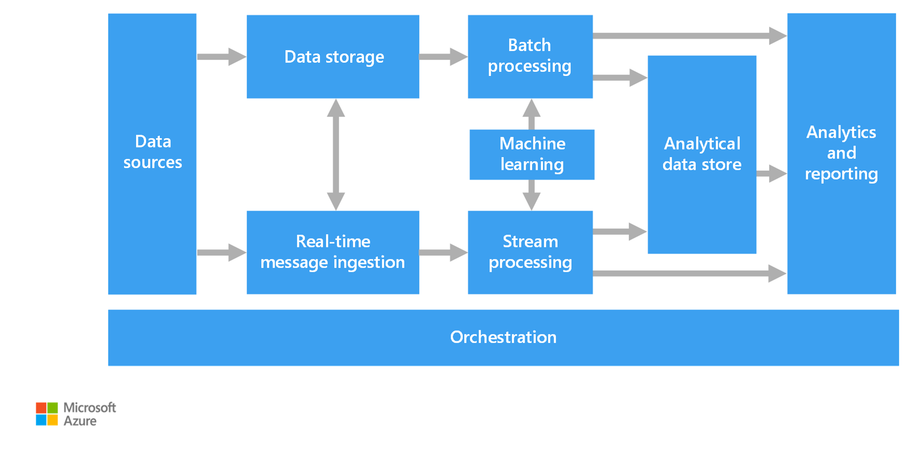

Slide 20
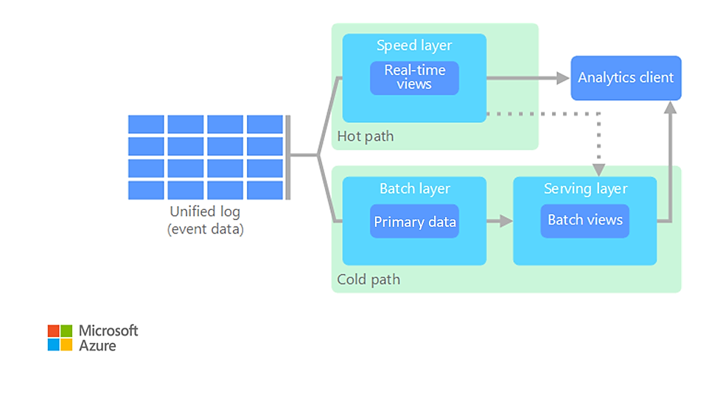
9
Lambda Architectures
When you work with large datasets, it can take a long time to run the type of queries that clients need.
These queries can't be performed in real time, and they often require distributed processing algorithms such as MapReduce that operate in parallel across the entire dataset.
The query results are stored separately from the raw data and used for further querying.
The Lambda architecture addresses this problem by creating two paths for data flow. All data that comes into the system goes through the following two paths:
  A batch layer (cold path) stores all the incoming data in its raw form and performs batch processing on the data. The result of this processing is stored as a batch view.
  A speed layer (hot path) analyzes data in real time. This layer is designed for low latency, at the expense of accuracy.
The batch layer feeds into a serving layer that indexes the batch view for efficient querying. The speed layer updates the serving layer with incremental updates based on the most recent data.

Slide 21
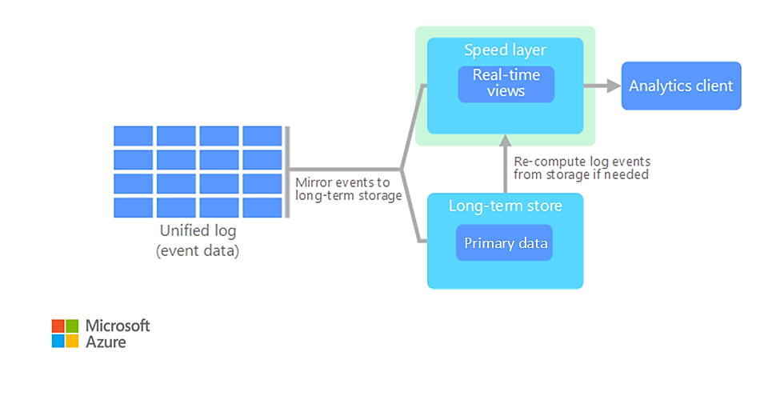
9
Kappa Architectures
A drawback to the Lambda architecture is its complexity.
Processing logic appears in two different places, the cold and hot paths, via different frameworks.
This process leads to duplicate computation logic and complex management of the architecture for both paths.
The Kappa architecture is an alternative to the Lambda architecture.
It has the same basic goals as the Lambda architecture, but all data flows through a single path via a stream processing system.
Similar to the Lambda architecture's batch layer, the event data is immutable and all of it is collected, instead of a subset of data.
The data is ingested as a stream of events into a distributed, fault-tolerant unified log.
These events are ordered, and the current state of an event is changed only by a new event being appended.
Similar to the Lambda architecture's speed layer, all event processing is performed on the input stream and persisted as a real-time view.

Slide 22
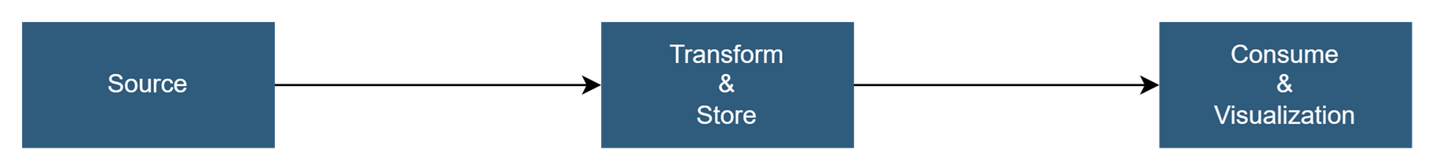
9
Data Lake Architectures
A data lake is a centralized data repository that stores structured data (database tables), semi-structured data (XML files), and unstructured data (images and audio files).
This data is in its raw, original format and doesn't require predefined schema.
A data lake can handle large volumes of data, so it's suitable for big data processing and analytics.
Data lakes use low-cost storage solutions, which provide a cost-effective way to store large amounts of data.
Common use cases for a Data lake architecture include:
  Unified analytics: Ideal for organizations that need a single platform for both historical and real-time data analysis
  Data governance: Ensures compliance and data quality across large datasets

Slide 23
9
Lambda, Kappa & Data Lake Architectures
Lambda Architecture
Kappa Architecture
Data Lake Architecture
Combines batch and stream processing.
Batch: Full historical dataset (Hadoop/Spark)
Speed: Real-time recent data (Streaming)
Serving: Merges both for queries
Limitation: Two code paths = complexity
Simplification of Lambda — eliminates batch layer.
All data treated as a stream.
Replayed from durable log (Kafka) for reprocessing.
Advantage: One code path
Best for: Stream-first systems
Centralized repository storing all raw data at any scale in native format.
Storage: HDFS or cloud (AWS S3, Azure)
Schema: Schema-on-read (not on-write)
Access: Spark, Hive, Presto
Risk: Without governance, becomes a "data swamp"
Architecture Comparison
Feature | Lambda | Kappa | Data Lake
Complexity | High (dual code) | Low (single code) | Medium
Latency | Low (speed layer) | Low | Variable
Best For | Accuracy + speed | Stream-first systems | Raw data storage

Slide 24
9
5. Latency, Throughput, Scalability & Resource Utilization
Latency
Throughput
Scalability
Resource Utilization
Time delay between request and response. Critical for real-time apps.
Data processed per time period. Essential for batch processing.
Handle increasing workloads. Horizontal vs Vertical scaling.
Efficient use of CPU, memory, disk I/O. Managed by YARN.
Latency vs Throughput Trade-off
Scalability Dimensions
• Low latency critical for real-time apps (fraud detection)
• Stream processing (Spark, Flink) for low latency
• Batch (MapReduce) trades latency for throughput
• YARN ensures efficient cluster utilization
Horizontal (Scale Out): Add more machines. Hadoop scales from single server to thousands.
Vertical (Scale Up): Add CPU/RAM. Traditional SQL — expensive with limits.
Cassandra is highly scalable.

Slide 25
1. Complexity
  Real-Time Processing (90) has the highest complexity because it requires immediate response, continuous monitoring, fault tolerance, and sophisticated infrastructure.
  Stream Processing (75) is moderately complex.
  Batch Processing (60) is comparatively simpler to implement and manage.
2. Scalability
  Batch Processing (90) scales very well for large volumes of historical data.
  Stream Processing (85) also scales effectively with distributed systems.
  Real-Time Processing (75) is scalable but maintaining very low latency at scale is challenging.
3. Throughput
  Batch Processing (95) achieves the highest throughput because data is processed in large chunks.
  Stream Processing (70) provides moderate throughput.
  Real-Time Processing (60) sacrifices throughput to achieve immediate response.
4. Latency
  Real-Time Processing (95) provides the lowest delay and fastest response.
  Stream Processing (85) offers near real-time responses.
  Batch Processing (30) has high latency because data is processed periodically rather than instantly.
✅ Real-Time Processing
  Best for applications requiring immediate decisions.
  Highest latency performance (fastest response).
  Most complex to implement.
  Examples: Autonomous vehicles, stock trading, medical monitoring.
✅ Stream Processing
  Balances latency and scalability.
  Suitable for continuous data flows.
  Examples: IoT analytics, fraud detection, social media monitoring.
✅ Batch Processing
  Best for processing massive datasets.
  Highest throughput and scalability.
  Not suitable when instant responses are required.
  Examples: Payroll processing, data warehousing, monthly reports.

Slide 26
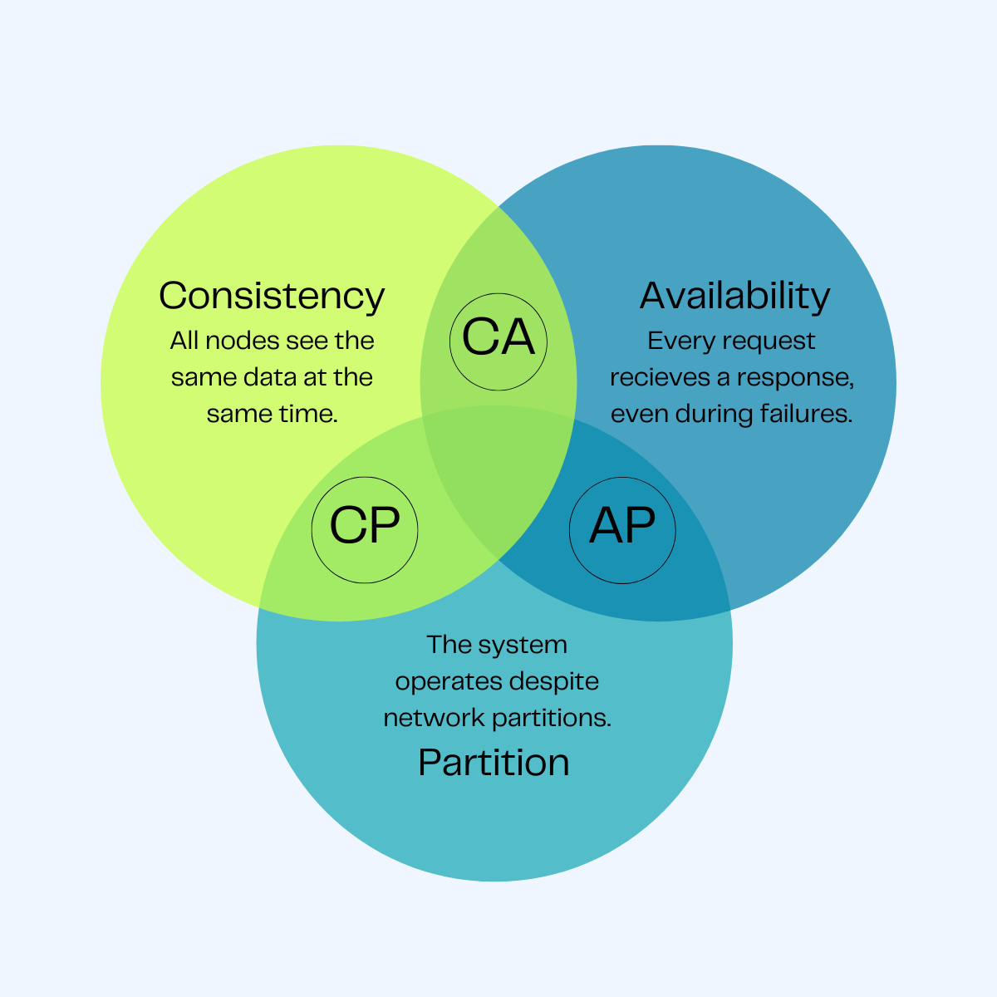
9
6. CAP Theorem & Database Comparison
CAP Theorem (Brewer's Theorem): A distributed data system can provide at most two of three guarantees simultaneously. Since network partitions are inevitable, systems must choose between Consistency and Availability.
Property | Definition | Example
Consistency | Every read gets the most recent write | HBase, MongoDB
Availability | Every request gets a response | Cassandra, DynamoDB
Partition Tolerance | System operates despite partitions | Required in all distributed systems

Slide 27
CAP Trade-Offs in Practice
Real distributed databases are built around one of three combinations
CP
Consistency + Partition Tolerance
Real-World Systems
Sacrifices availability during a network split
MongoDB, HBase, Redis (default mode)
AP
Availability + Partition Tolerance
Real-World Systems
Cassandra, DynamoDB, CouchDB
Sacrifices strict consistency during a split
CA
Consistency + Availability
Real-World Systems
Traditional single-node RDBMS (MySQL, PostgreSQL)
Only holds when there is no network partition

Slide 28
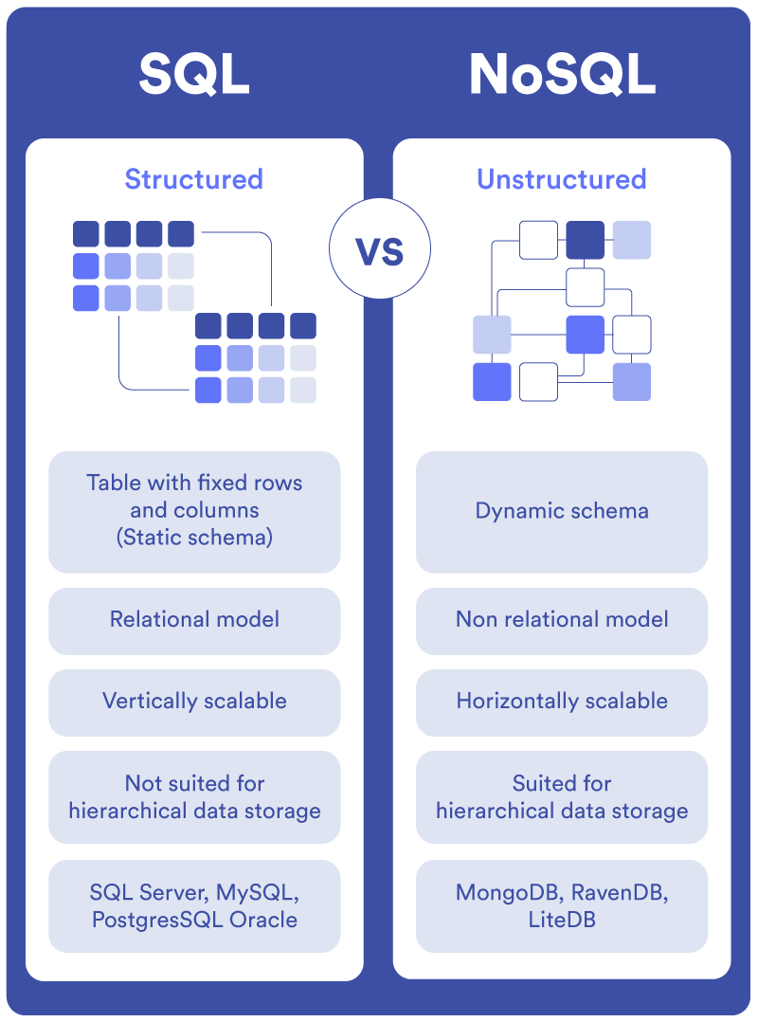
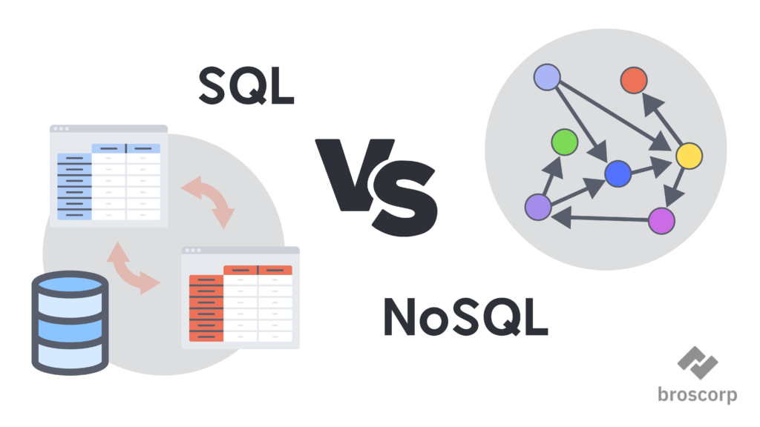
9
SQL vs NoSQL vs NewSQL
Type | Consistency | Availability | Scaling
SQL / RDBMS | ACID (Strong) | High (single node) | Vertical
NoSQL | BASE (Eventual) | Very High | Horizontal
NewSQL | ACID (Strong) | High (distributed) | Horizontal

Slide 29
9
Storage, Computation & Communication Trade-offs
Storage Cost
Computation Cost
Communication Cost
• Storing raw/unstructured data requires significant capacity
• HDFS uses 3x replication for fault tolerance
• Data lakes store raw data; warehouses store curated data at higher cost
• Archive cold data to cheaper storage tiers
• Processing large datasets needs substantial CPU and memory
• Hadoop: move computation to data (data locality)
• Spark in-memory faster but more expensive than MapReduce
• YARN manages resource allocation
• Moving data across nodes consumes bandwidth and increases latency
• MapReduce shuffle phase is a major source of communication cost
• Data locality minimizes network transfer
• Combiners reduce intermediate data volume
Key Trade-offs Summary
Trade-off | Description
Storage vs Computation | Pre-computed results (materialized views) reduce computation but increase storage
Computation vs Communication | Running computation close to data (data locality) reduces communication but needs scheduling flexibility
Storage vs Communication | Caching frequently accessed data locally reduces communication but uses more storage
Batch vs Real-Time | Batch maximizes throughput but has high latency; streaming minimizes latency but increases complexity and cost

Slide 30
9
7. Data Governance Principles
Data Governance is the set of processes, policies, standards, and organizational structures that ensure data is managed as a valuable enterprise asset.
1
Data Quality Management
2
Data Security & Privacy
Ensures data is accurate, valid, reliable, timely, relevant, and complete. Governance applications validate sources, clean datasets, and enforce quality standards.
Protects sensitive data from unauthorized access and breaches. Includes encryption, identity/access control, compliance with GDPR, HIPAA, PDPB, and endpoint protection.
3
Data Lineage & Audibility
4
Data Access & Authorization
Tracks data origin, movement, and transformations. Ensures traceability, accountability, and reproducibility of analytical results.
Defines who can access which data under what conditions. Role-based access control (RBAC) ensures users access only data relevant to their roles.
5
Compliance & Regulatory Adherence
Organizations must comply with applicable data regulations. Governance frameworks ensure data collection, storage, processing, and sharing practices meet legal requirements and avoid regulatory penalties.

Slide 31
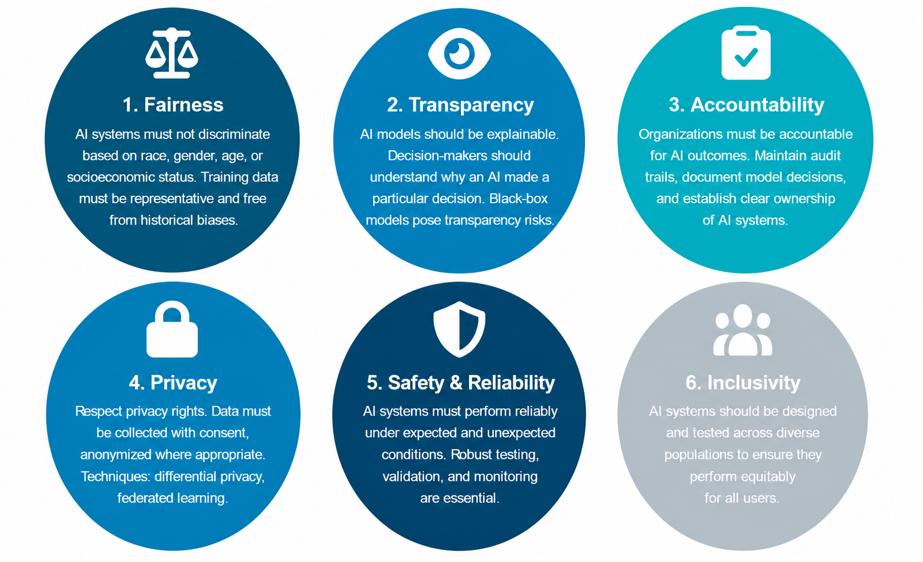
9
Responsible AI Principles
Responsible AI refers to the development and deployment of AI systems in a manner that is ethical, fair, transparent, accountable, and safe.

Slide 32
9
Responsible AI Principles
Responsible AI refers to the development and deployment of AI systems in a manner that is ethical, fair, transparent, accountable, and safe.
Real-world examples of responsible AI in action span across several major industries:
Healthcare (Explainable Diagnostics): Hospital systems and health-tech platforms use AI to scan medical images for conditions like cancer. To ensure accountability, the most trusted AI programs don't just provide a diagnosis. They also highlight the specific features in the image that led to their conclusion, allowing doctors to verify the AI's reasoning alongside their clinical judgment.
Human Resources (Fair Recruiting Software): Enterprise HR tools like IBM watsonx Orchestrate utilize responsible frameworks to ensure fairness in talent acquisition. These systems promote inclusivity by broadening candidate pools and prompting managers to utilize fair, skill-based assessment criteria rather than demographic triggers.

Slide 33
9
Responsible AI in the Big Data Pipeline
Pipeline Stage | Responsible AI Consideration
Data Collection | Obtain informed consent; avoid collecting unnecessarily sensitive data; ensure representative sampling
Data Storage | Apply access controls; encrypt sensitive data; comply with data retention policies
Data Processing | Document transformations; detect and mitigate bias in preprocessing steps
Model Training | Use diverse, representative training data; audit for bias; document model parameters
Model Deployment | Monitor model performance in production; detect drift; maintain audit logs
Model Output | Provide explanations for decisions; allow appeals/corrections; ensure fairness of outcomes
Business Intelligence & Data Governance
Business Intelligence (BI) converts raw data into meaningful information that drives profitable business actions. BI supports fact-based decision making.
• BI tools create reports, dashboards, maps, graphs, and charts
• Governance ensures BI data is accurate, consistent, trustworthy
• KPIs are meaningful only if data meets quality standards

Slide 34
9

